Slide 1







COMPANY PROFILE
Candor Logistics LLP
An International freight forwarding company

Slide 2

Company
Background
Candor Logistics LLP's head office, nestled in Mumbai, India, is an international freight forwarding company with IATA & MTO licenses, specializing in personalized service for pharma, fragile cargo, cross-country, and time-bound shipments.??Since 2014, we have forged exclusive agreements with global IATA agents, airlines & liners, moving not just cargo but possibilities, connections, and dreams.

Slide 3

Vision and
Mission
Our Mission is To Meet our Customer's Expectation:
“Early, Economically,
Efficiently with Equality” to
SQUARE DEALS!
As for the Vision, we are committed to be most trusted Freight Forwarder
“Nationally & Internationally”

Slide 4

What we
Do
We redefine industry standards by providing international freight forwarding services with personalized customer care and expertise, specializing in pharma, fragile cargo, cross-country, and time-bound shipments.

Slide 5

Why
Us
We like delivering transparency and reliability, for small and big cargo alike.
We are available 24/7 to ensure safety and to provide timely updates of your cargo hence letting you be at your peace of mind.

Slide 6
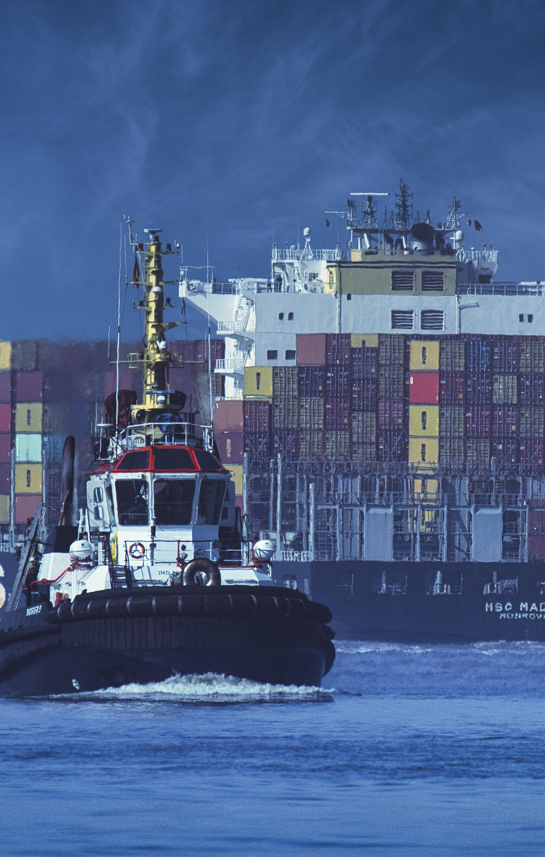
Our
Services
Air Imports & Exports
Sea Imports & Exports
Cross Country Shipments
Warehousing & Distribution
Sourcing & Procurement
Project Cargo Shipments
Custom Clearance
Domestic Transportation

Slide 7



Contact
Head Office: 231, Adarsh Industrial Estate, Chakala, Andheri (E),
Mumbai – 400 099, India.
info@candorllp.com
opsmum@Candorllp.com
rinu@candorllp.com
www.candorllp.com
Us
Branches:
PUNE Aspiro Commercial Spaces Office No.204, 2nd Floor, Opposite Thyssenkrup Company, Station Road, Pimpri, Pune - 411 018 India.
masoom@candorllp.com
BANGALORE 3rd Floor, 423/1 - Manushri Towers, 5th Main, 6th Cross, OMBR Layout, Bangalore – 560 043, India.
kochu@Candorllp.com

